Slide 1

CS65: Mini Project Work - Zeroth Review Presentation
Department of Computer Science and Engineering
Optimized neural network model for the detection of ocular diseases
Team:
1MS21CS037 – Bharmal Hamza
1MS21CS010 – Akash Badadani
1MS21CS043 – Danish Bashir
1MS21CS031 – Aryan Gupta
Guide:
Akshatha Kamath
Assistant Professor
Dept of CSE

Slide 2
Agenda
Problem Statement:
Objective & Scope of the Proposed Project:
Hardware & Software to be used:
What contribution to society would the project make?
References
25-03-2024
Computer Science and Engineering
2

Slide 3
Introduction
What:
Objective: Develop an optimized neural network for ocular disease detection.
Scope: Analyzing ocular images to identify diseases or abnormalities early on.
Why:
Early Detection: Improving treatment outcomes and preventing vision loss.
Accessibility: Providing remote access to healthcare, especially for underserved areas.
Efficiency: Automating detection with ML can speed up diagnoses, easing the load on healthcare workers.
25-03-2024
Computer Science and Engineering
3

Slide 4
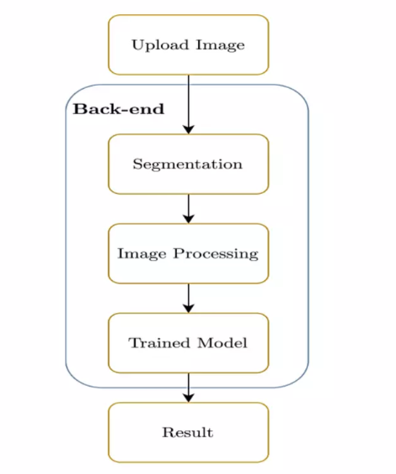
Introduction
How :
Image Enhancement and analysis
Mobile technology
Computer vision
Motivation:
Healthcare Accessibility: Limited access to eye care services in remote areas.
Early Detection: Crucial for timely intervention and improved outcomes.
Enhancing Patient Safety: By minimizing the risk of overlooking critical details or misinterpreting complex cases.
25-03-2024
Computer Science and Engineering
4

Slide 5
START
Normal
Diabetes
Glaucoma
Cataract
Hypertension
Myopia
Camera image
Fundus Image
Image Processing
Deep Learning Analysis Model
Image Enhancement
Category:
point-like corneal ulcers
point-flaky mixed corneal ulcers
flaky corneal ulcers
Deep Learning Analysis Model
Conjunctivitis
Types
type 0 : No ulcer of the corneal epithelium
type 1 : Micro punctate
type 2 : Macro punctate
type 3 : Coalescent macro punctate
type 4 : Patch (>=1 mm)
Image processing
(Enhancing)

Slide 6
Problem Statement
1. Current Methodology:
Relies on specialized equipment and expertise for eye disease detection.
Accessibility is limited, especially in remote areas lacking infrastructure.
Costly and hard to afford for many individuals and healthcare systems.
2. Proposed Methodology:
Create a resilient deep learning model for early detection utilizing both fundus and standard camera images, aimed at mitigating avoidable blindness and enhancing patient prognosis.
Creates a user-friendly mobile application for easy accessibility.
Serves as a tool for healthcare professionals for quick detection, allowing for later verification and detailed analysis.
25-03-2024
Computer Science and Engineering
5

Slide 7
Project Objectives
Develop a robust deep learning model for accurate detection using both fundus and simple camera images.
Implement image processing techniques to enhance input image quality and improve model performance.
The proposed model would be able to guide the users to know their eye condition.
Deliver comprehensive insights on eye-related conditions and disorders through an accessible and user-friendly interface.
25-03-2024
Computer Science and Engineering
6

Slide 8
SRS
Software:
Backend Development: Node JS, Flask.
Deep Learning Model Development: TensorFlow or PyTorch.
Image Processing: OpenCV
Mobile App Development: React Native or Flutter
Hardware:
Standard digital cameras and smartphones for capturing eye images
Specialized fundus cameras for acquiring fundus images (for advanced diagnostics)
25-03-2024
Computer Science and Engineering
7

Slide 9
What contribution to society would the project make?
Enhanced Accessibility: The model enables early detection of ocular diseases using phone-captured images, particularly benefiting rural and underserved areas while potentially reducing healthcare costs.
Early Detection and Prevention: By identifying conditions like glaucoma and myopia early on, the software facilitates timely intervention, fostering preventive healthcare and promoting awareness about eye health.
Community Health Initiatives: The model can be integrated into community health programs and outreach efforts, facilitating widespread screening campaigns and raising awareness about the importance of regular eye examinations.
Technological Innovation: Promoting technological literacy and serving as a foundation for future health tech advancements, the model sets a precedent for telemedicine and digital health applications.
25-03-2024
Computer Science and Engineering
8

Slide 10
References
Akram A, & Debnath, R. (2020). "An automated eye disease recognition system from visual content of facial images using machine learning techniques".
. Mohamed Elkholy & Marwa Abd El Azeem (2024, January). "Deep learning-based classification of eye diseases using Convolutional Neural Network for OCT images”
Stewart Muchuchuti & Serestina Viriri (2023,April). "Retinal eye disease detection using deep learning".
Sarki, R., Ahmed, K., Wang, H., & Zhang, Y. (2020). "Automatic detection of diabetic eye disease through deep learning using fundus images: A survey".
Malik, S., Kanwal, N., Asghar, M. N., Sadiq, M. A. A., Karamat, I., & Fleury, M. (2019). "Data-driven approach for eye disease classification with machine learning".
25-03-2024
Computer Science and Engineering
8

Slide 11
Thank You
25-03-2024
Computer Science and Engineering
10

